Slide 1
Image Caption Generator - Project Outline

Slide 2

Presented By :
Team Perfect Squares:
Durgesh Mishra
Jai Saxena
Niranjan Solanki
Pankaj Balchandani

Slide 3
Outline
Problem Statement
Problem Solution
Project workflow
Data
Models

Slide 4
Problem Statement
Image Captioning is the process of generating a textual description for given images. A challenging problem in Deep learning is to auto-generate caption for an image.
To understand the context of an image and describe it in a human language like English, Image Caption Generator uses both Natural Language Processing (NLP) and Computer Vision to generate the captions.

Slide 5
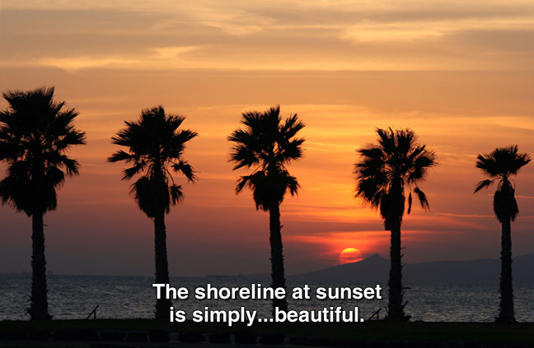
Problem Solution
We plan to build a user interface where given an image, we generate the relevant caption for that particular image using Computer vision & NLP-based models.

Slide 6
Project Scope
Proof Of Concept (POC)
Prototype
Minimum Viable Product (MVP)
Preprocess Image and Caption data
Experiment on some baseline models and approaches.
Visualize model activations to analyse whether the captions. generated are relevant or not.
Create a mockup of screens to see how the app could look like
Deploy one model to Fast API to service model predictions as an API
Create App to generate caption for an uploaded image
API Server for uploading images and predicting using best model

Slide 7
Project Workflow
POC
Prototype
MVP
Data Collection
Setup Experiment Tracking
Build Baseline Models
Build Better Models
Project, Containers, Deployment Setup
Build Caption generating App

Slide 8
Dataset & Models
We will be experimenting with 2 datasets, whichever gives better result:
Flikr8K (32kimages) (https://www.kaggle.com/code/hsankesara/image-captioning/data
Coco Caption(328k images) https://paperswithcode.com/dataset/coco
Model:
Convolutional Neural Network
To choose from RNN, GRU, LSTM and Bert implementation point of view.

Slide 9
Thank you!!

